Slide 1

SUPPLY CHAIN CHALLENGES & DATA-DRIVEN FORECASTING SOLUTIONS

Slide 2






Agenda
Raw Material Gap
Production Gap
Dispatch and Delivery
Retail Order Distortion
Inventory Gap
Sales Fulfillment Gap

Slide 3
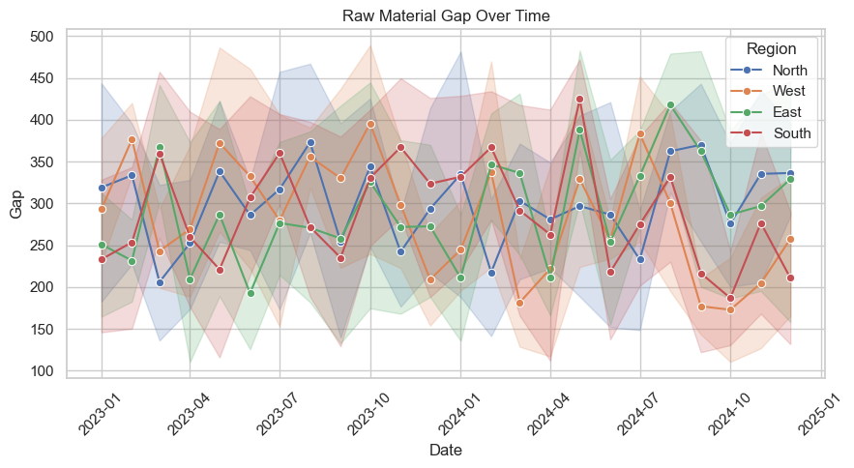
Graph 1: Raw Material Gap Over Timeap
RAW MATERIAL GAP
🌍
No seasonal or trend cycles
📉
Month-to-month gap volatility
📊
West & South show high unpredictability

Slide 4
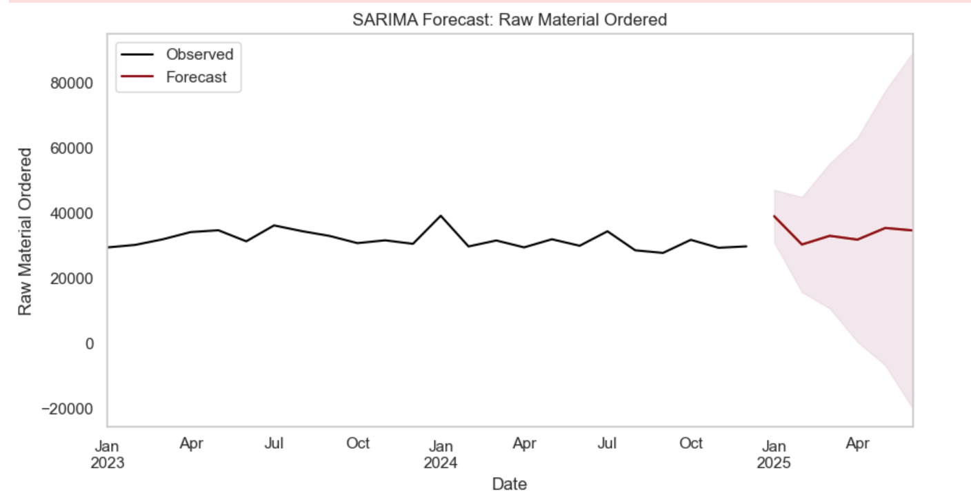
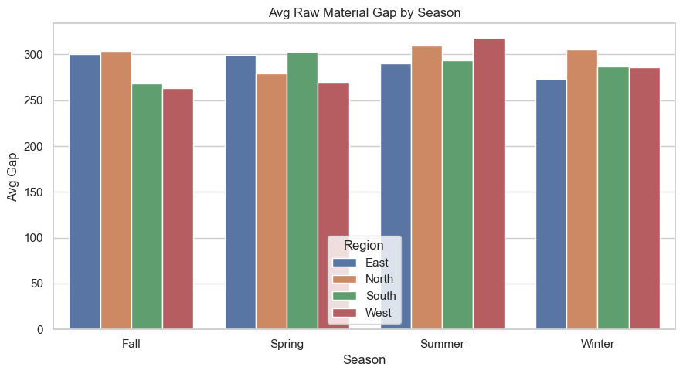
📊 Graph 2: Avg Raw Material Gap by Season
🔥❄️ Summer & Winter: high gaps (West/South)
🧭 East = stable, North = mild winter issue
📉 Seasonal risk not addressed in planning

Slide 5
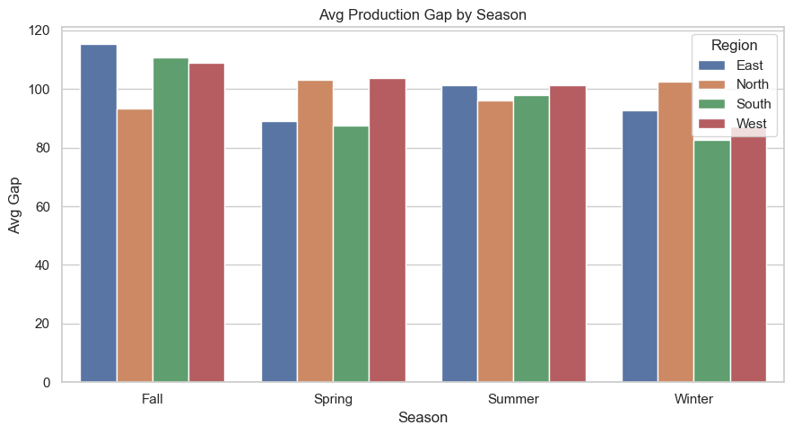
📊 Graph 2: Avg Production Gap by Season
🍂 Fall: East spikes
❄️ North: Winter peak
🚫 Mismatch with capacity & resources

Slide 6
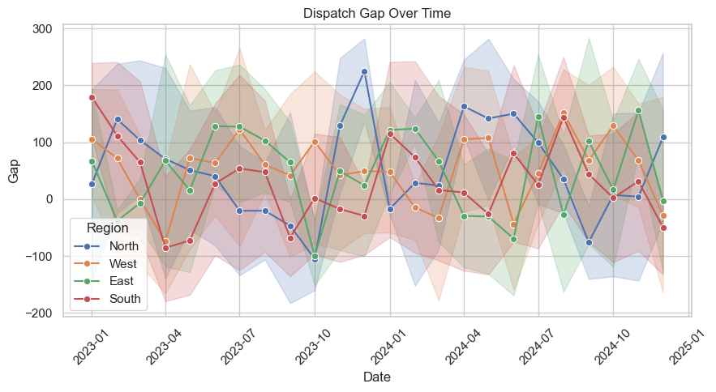
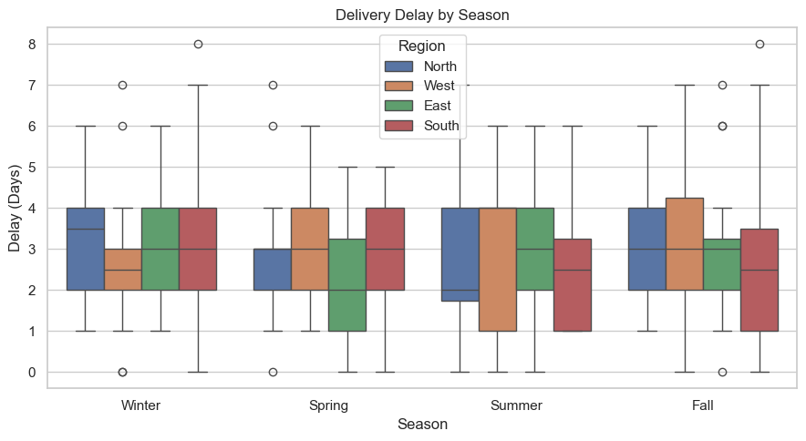
Fo📈Graph 3: Dispatch Gap Over TimeHorizon: Next 6 months
DISPATCH & DELIVERY DELAYS
↕️ Frequent under/over-fulfillment
🧊 South = excess inventory
🧭 North/East = dispatch shortfalls

Slide 7
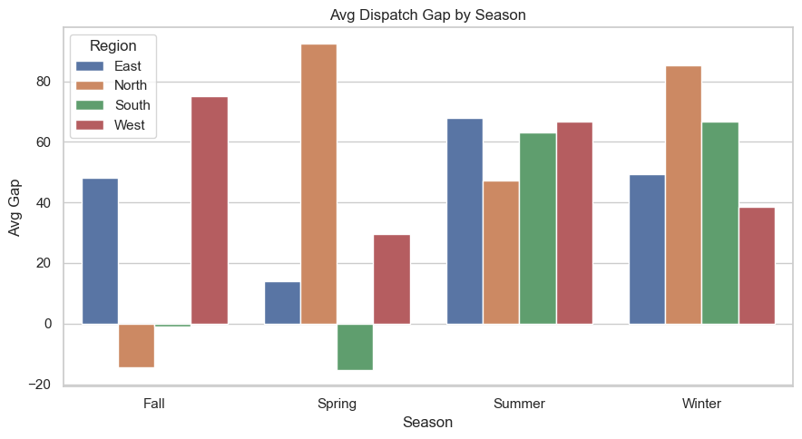
📊 Graph 2: Avg Dispatch Gap by Season
🌱 Spring = high gap (North/East)
❄️ Winter = West delay zone
🚧 Peaks unmanaged

Slide 8
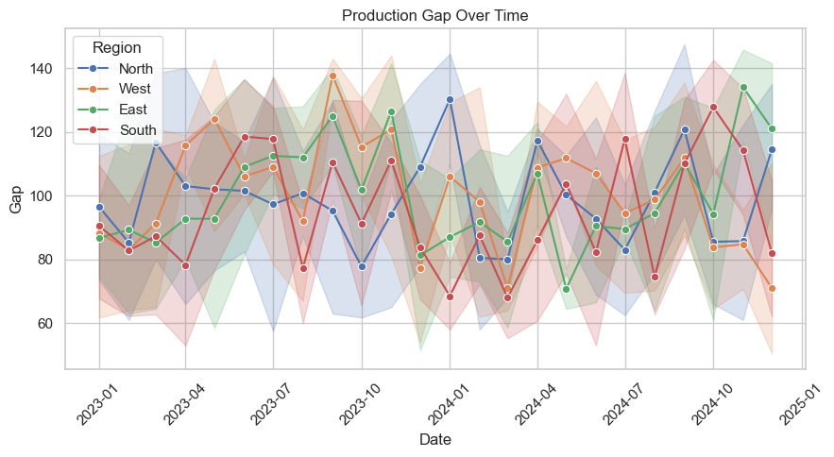
📊 Graph 1: Delivery Delay by Season
📦
South = 7-day delays (Fall/Winter)
🧊
Seasonal transport disruptions
🚛
Logistics not winter-ready

Slide 9
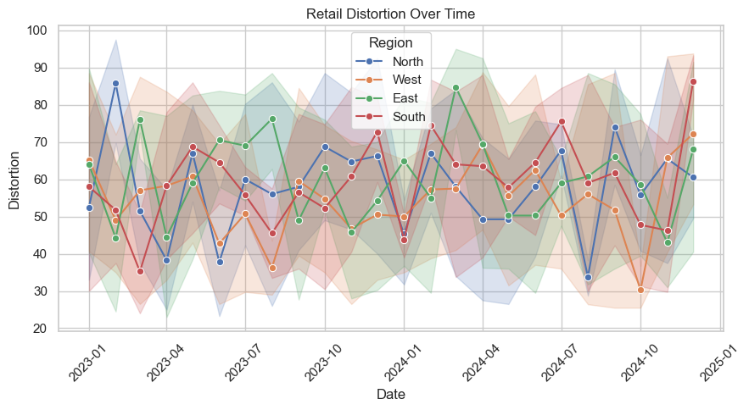
🛒 RETAIL ORDER & DISTORTION
📊 Graph 2: Retail Distortion over time
🔁 Volatility = missed sales / overstock
🧭 North = most unstable
🕶️ Planning blind spots

Slide 10
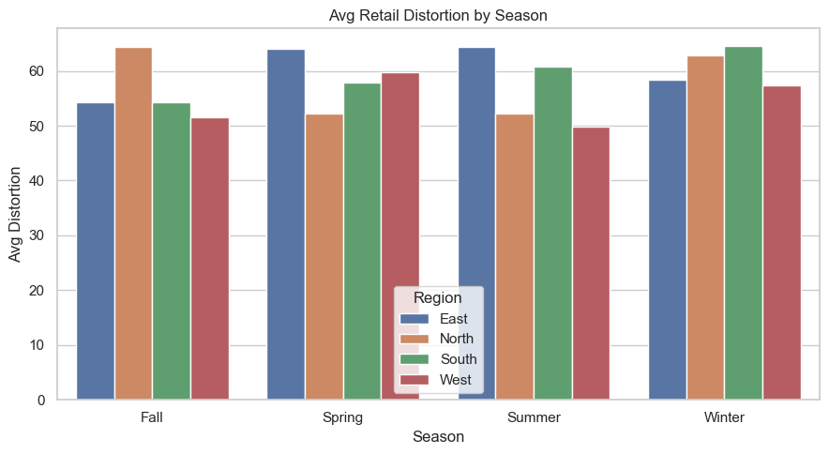
📊 Graph 3: Avg Distortion by Season: Next 6 months
🍂 North = Fall spike, ❄️ South = Winter spike
🚫 No region-season strategy
📋 Generic planning fails

Slide 11
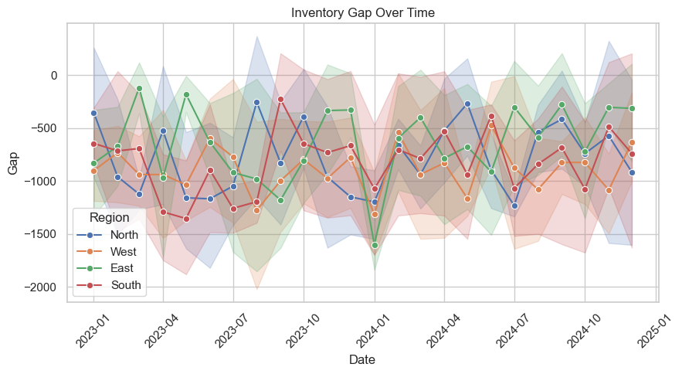
📦 INVENTORY GAP
📊 Graph 1: Inventory Gap Over TimeG
📉
Consistently negative gaps
🧊
South worst hit
⚠️
Risk of stockouts

Slide 12
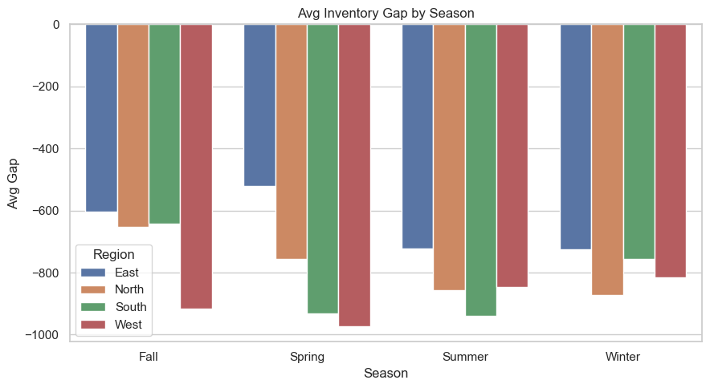
📊 Graph : Avg Inventory Gap by season
❄️ Fall/Winter = worst for South
🚚 Regional shortage persists
🧰 Needs seasonal stock prep

Slide 13
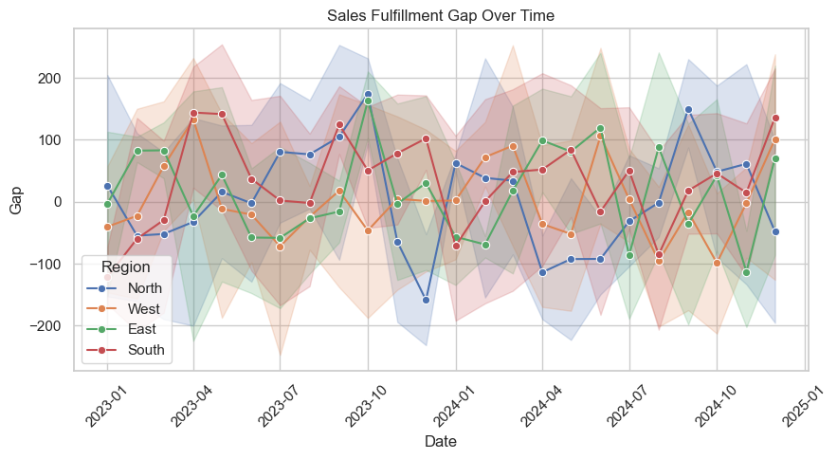
💰 SALES FULFILLMENT GAP
🧭
Sales gaps vary heavily by region
🙍
Customer service risk
🔄
Needs consistent supply alignment

Slide 14
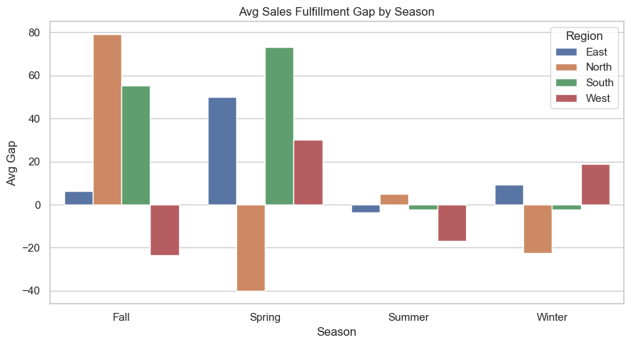
📊 Avg Fulfillment Gap by Season 6 months
🍂 South = Fall shortage
🌸 East = Spring unfulfilled sales
❌ Inventory misaligned with season

Slide 15


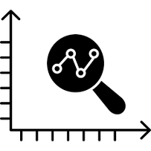
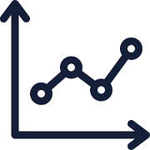
FORECASTING SOLUTIONS
SARIMA Seasonal Autoregressive Integrated Moving Average
Forecasting Horizon: Next 6 months
Observed values
Forecasted values
Confidence interval

Slide 16


RAW MATERIAL FORECASTING
Predict upcoming demand & gaps
Smooth trendlines reduce overreactions
Region-specific forecasts
Proactive procurement
Lower volatility in high-risk seasons

Slide 17
Data Driven Predictions
Safety Stock Policies
Advance Planning

Slide 18



Production Forecasting
Stabilizes regional production plans
Incorporates seasonal patterns
Offers 3–6-month visibility
Improves shift scheduling
Reduces overtime, idle time, and
emergency procurement

Slide 19
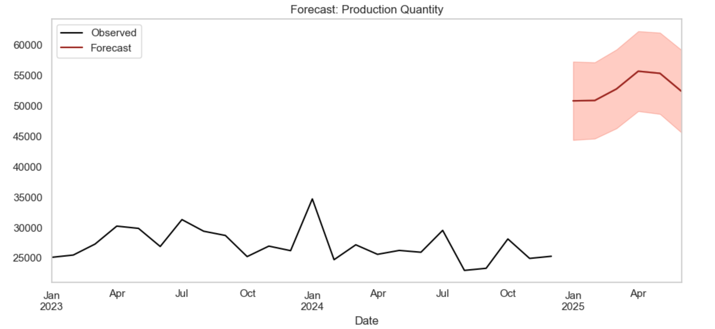
Forecast confidence intervals narrow.
seasonal trends .
shaded area shows upper/lower production estimate bounds.

Slide 20

Dynamic models account for external factors
Season-aware dispatch predictions
Confidence intervals guide transport planning
Dispatch & Delivery Forecasting
Reduces
Spring/Winter dispatch gaps
Improves on-time deliveries

Slide 21
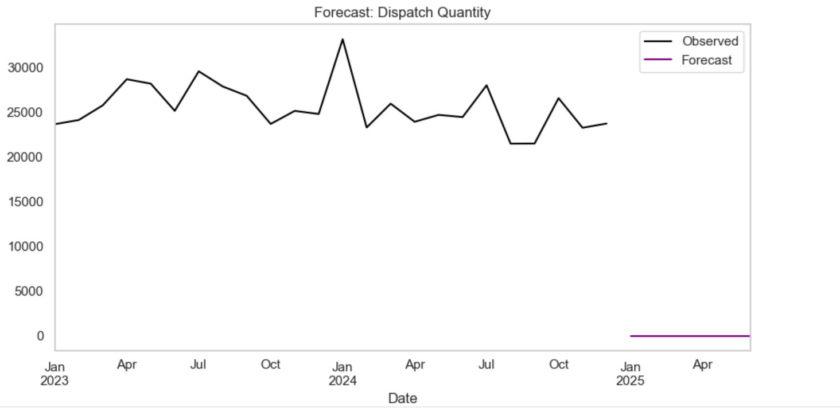
significant fluctuations
little anticipated growth
limitations in the forecasting model

Slide 22

Identifies future demand trends
Region- and season-specific order forecasts
Confidence bands help manage risk
Retail Order Forecasting
Cuts down retailer distortion
Enables tailored warehouse & vendor plans

Slide 23
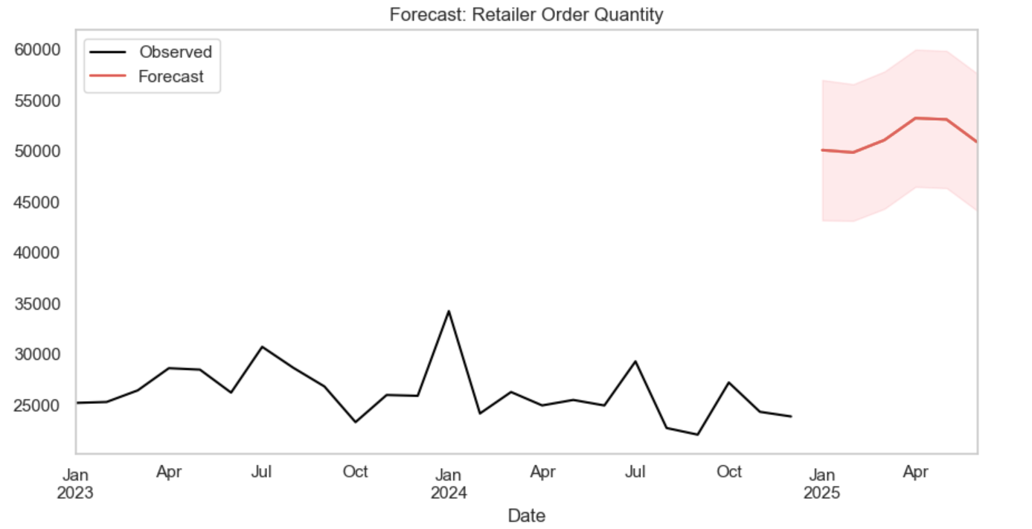
Forecast shows a rising trend in early 2025.
The confidence interval accounts for forecast uncertainty.

Slide 24
Identifies future demand trends
Region- and season-specific order forecasts
Confidence bands help manage risk
Retail Order Forecasting
Cuts down retailer distortion
Enables tailored warehouse & vendor plans

Slide 25
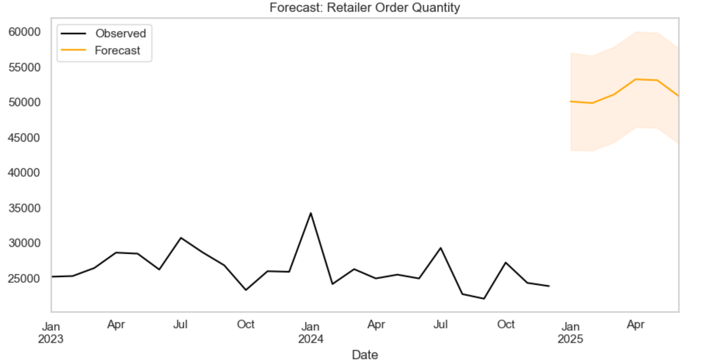
Retail Order Forecasting
Black Line: Actual retailer order quantities from Jan 2023 to Dec 2024.
Orange Line: Forecasted order quantities
Shaded Orange Area: Confidence interval

Slide 26

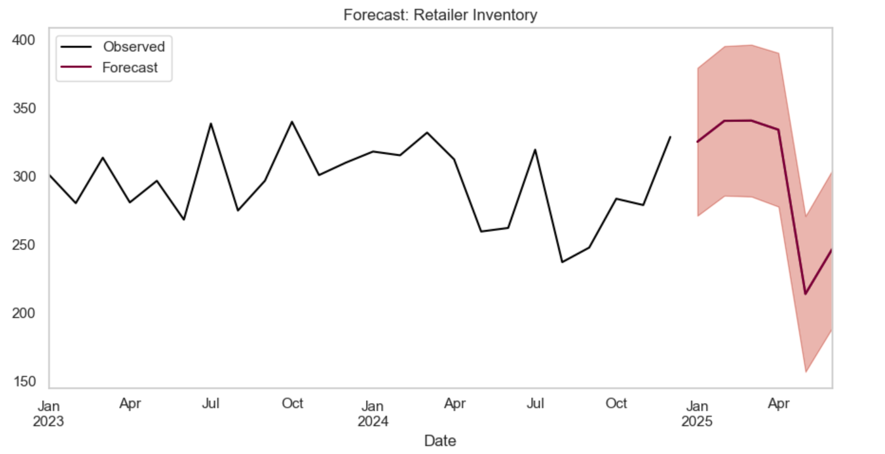
Forecast Retail Inventory
stabilized inventory levels.
increase gradually in the future, especially after Jan2024
inventory level closer to 350 units.

Slide 27

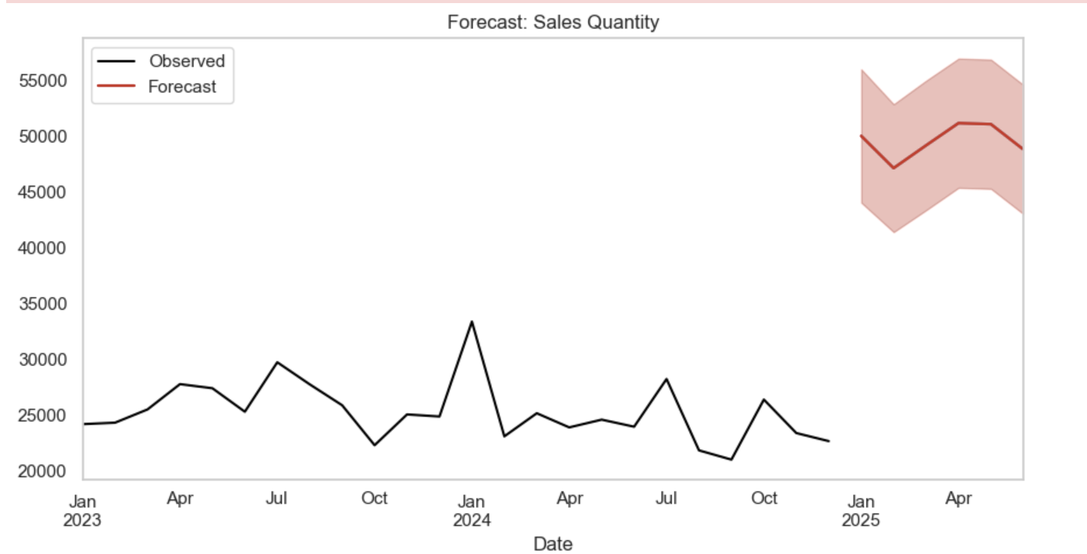
Forecast Sales Quantity
In
consistency in actual sales performance.
smoother and gradually increasing trend
shaded region

Slide 28
1
Operational Gaps Identified
2
Better Decision-Making
Conclusion
3
Resilient Supply Chain
4
Cost & Risk Reduction

Slide 29


Slide 30
THANK YOU

